Slide 1
Project 3: Web APIs & NLP
Using reddit’s api and predict post content
Pan Kah Fei DSIF-5
August 13, 2022

Slide 2
Agenda
Problem Statement
Methodology
Result
Conclusion and Recommendation

Slide 3


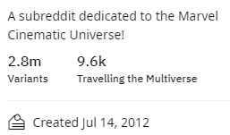

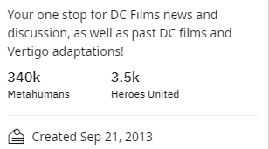
Problem Statement
Classify the subreddit posts using Natural Language Processing(NLP) and classication models.
1.r/marvelstudios
2.r/DC_Cinematic
The contents are similar (superhero, movie, meme etc)
How well can they can be classified using NLP and SKLearn’s classification model?

Slide 4





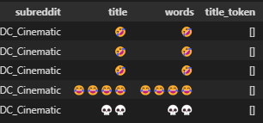
Methodology
Web Scrapping & Cleaning
Modelling
Exploratory Data Analysis(EDA)
Pre-processing
Model Selection & Evaluation
‘Pushshift API’ to extract posts from Reddit
2000 posts scrapped from each page
Cleaning
Convert .Jason file into Pandas dataframe
Remove blanks, duplicates, emojis
Select only ‘title’ and ‘self-text’ as feature columns

Slide 5
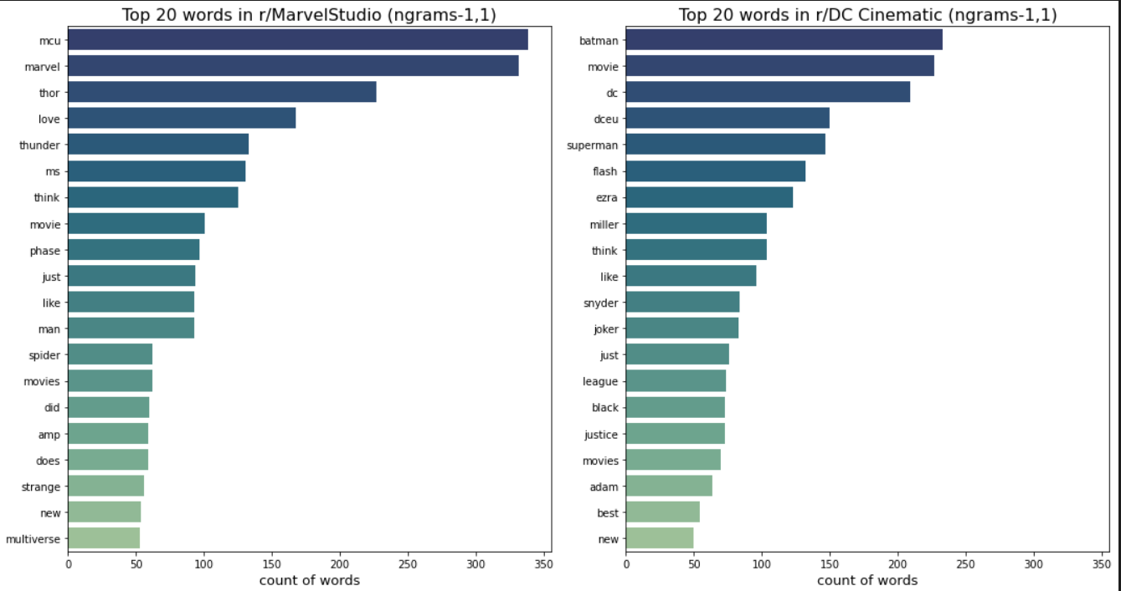
Exploratory Data Analysis (EDA)
Methodology
Balanced Data:
Class 0 = r/marvelstudios (50.02%) , Class 1 = r/DC_Cinematic(49.97%)
Tokenize and Counvectorize with different N-grams.

Slide 6
Methodology
Pre- processing
Prepare data for Natural Language Processing (NLP) Model
Stop words removal
Use nltk ‘English’ stopwords library.
Tokenizing
Use Regular expression to parse string into multiple tokens
Lemmatizing
Reduce token words by removing suffixes but lighter touch than stemming

Slide 7
Methodology
Pipeline
Train size: 75%, Test size: 25%
RandomizedSearchCV
(1000 iteration, 3CV)
Trained Model
1. Logistic Regression
2. K Neighbors Classifier
3. Decision Tree Classifier
4. Support Vector Classifier
5. Multinomial Naive Bayes Classifier
6. Random Forest Classifier
7. Stacking (Voting)
8. Bagging
9. Boosting (ADA Boost and Gradient Boost
GridsearchCV on top 3 models
Best Model
Counvectorizer
Modelling
Train test split on lemmatized dataset
Use sklearn’s RandomizedSearchCV to have an initial guess on hyperparameter range of each model
Pipeline groups of models with preprocessors
Use sklearn’s GridSearchCV to get the best hyperparameter
TF-IDF
Models

Slide 8
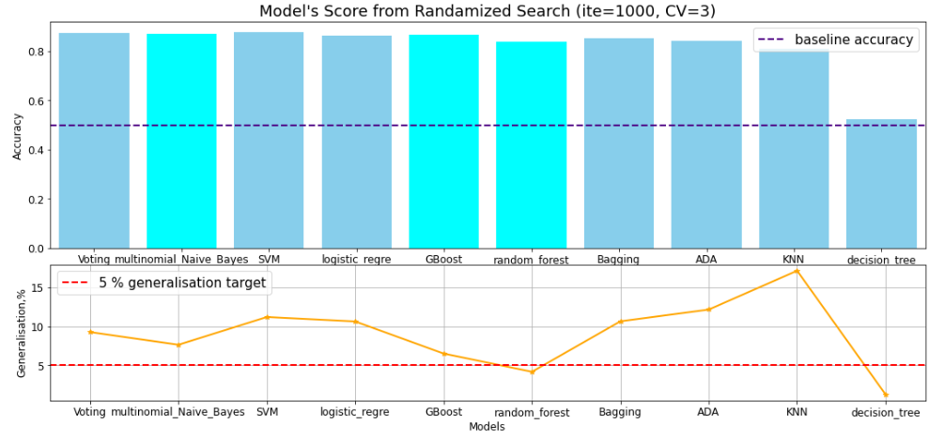
Methodology
1st step: Randomized Search
0.87
0.86
0.84
Model Selection
RandomizedSearch result is good enough to select the top 3 models
Multinomial Naïve Bayes
Gradient Boost(Decision Tree)
Random Forest
Then follow by GridSearchCV to find the best performer
2nd step: Grid Search
Model | Pre-processor | Train Score | Test Score | Test Score Improvement | Generalisation | Test ROC AUC | Actual Runtime (min) | Runtime (Full grid search, min)
MNB | Count Vectorizer | 0.94 | 0.87 | 0% | 7.4% | 0.96 | 0.51 | 4555
RF | Count Vectorizer | 0.89 | 0.85 | 1.2% | 4.53% | 0.95 | 4.45 | 6220877
GBOOST | Count Vectorizer | 0.92 | 0.87 | 1.2% | 6.3% | 0.95 | 5.5 | 6121

Slide 9
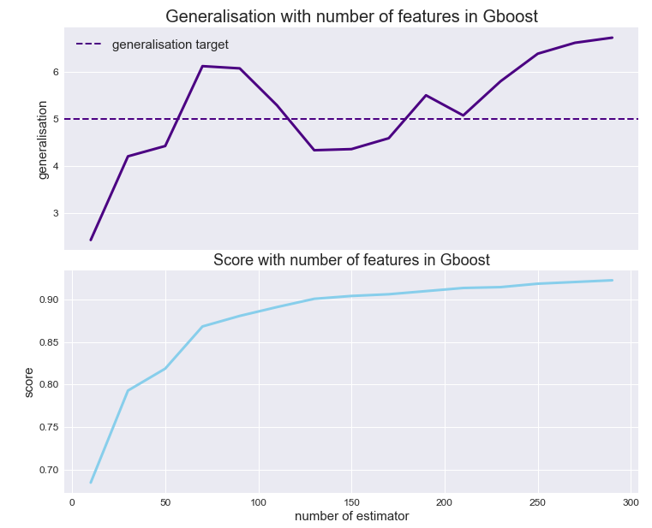
Methodology
6.3%
Model Selection
Further study on Gboost to narrow down generalization gap:
Shrinkage/Weighted Updates
- learning rate
- number of estimator
Random Sampling/Stochastic Boosting
- subsample
4.4%
0.90
0.92
-2.17%
150 number of estimator is chosen for gradient boost model

Slide 10
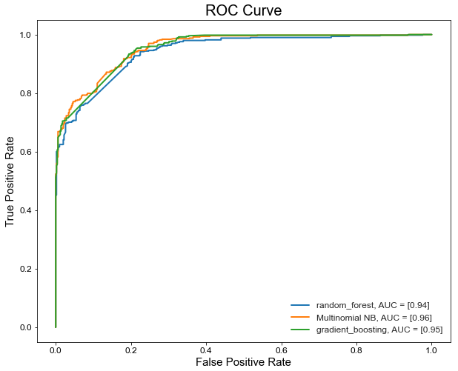
Methodology
Evaluation
The generalization gap must <5% as requested for this project
All beat baseline accuracy of 50%
Model | Pre-processor | Train Accuracy Score | Test Accuracy Score | Generalisation | Test ROC AUC | Test F1 score(class 0) | Test F1 score(class 1)
MNB | Count Vectorizer | 0.92 | 0.86 | 7.4% | 0.96 | 0.87 | 0.86
RF | Count Vectorizer | 0.88 | 0.84 | 4.53% | 0.94 | 0.85 | 0.83
GBOOST | Count Vectorizer | 0.90 | 0.87 | 4.36% | 0.95 | 0.86 | 0.88

Slide 11
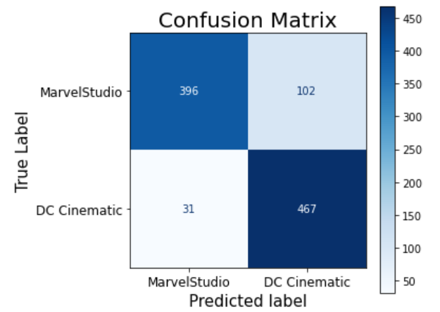
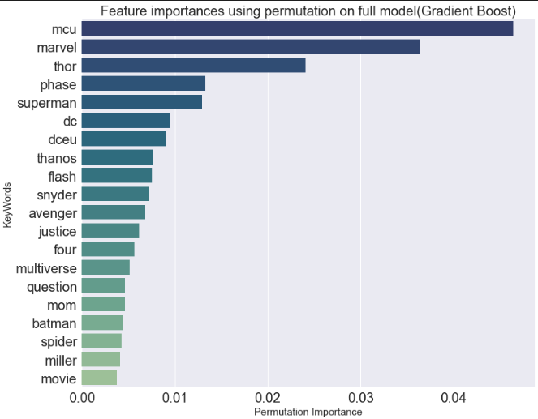
Result
Confusion matrix
F1 score 88%
Accuracy score 87%
Best performance with threshold of 0.5
Winner - Gradient Boost
CountVectoriser
max_df=0.85
Max_feature=1500
ngram_range = (1,1)
Parameter
Learning_rate=0.12
Max_dept = 4,
Max_features = 12
Min_sample_leaf =2,
N_estimator=150,
Min_sample_split=10
Permutation Importance
Model-agnostic global explanation method
Top 20 words with high predictive power

Slide 12
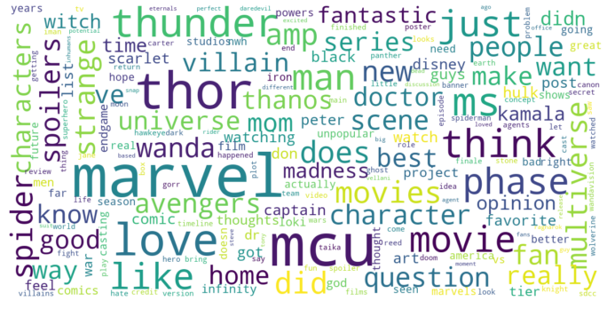

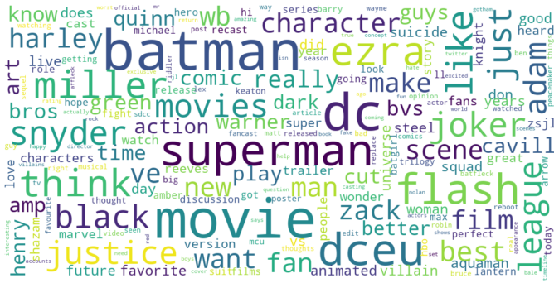

Word Cloud Visualization on key terms for each sub:
r/marvelstudios
r/DC_Cinematic

Slide 13
Conclusion & Recommendation
Highest-performing model, Gradient Boost is doing well in predicting the subreddit posts with accuracy of 87%
Every model has its pros and cons, we must gauge the trade off between the computation time and target scores.
The method of using randomizedsearchCV to narrow down the hyperparameter range followed by full GridsearchCV able to save whole computing time by enormous amount (1112% shorter run time for Gradient boost model).
Advance model like CatBoost and XGBoost can be tested out in the future for NLP project

Slide 14
Thank you Q & A

